Slide 1
Tips & Tricks: Adding Equations to MS Office Documents
Enhancing reports and instructional materials
with professional looking formulas

Slide 2
Preface
Audience: Students/Instructors who
Produce reports/instructional material
Have basic typing skills
Use (Greek) symbols and formulas in their documents
Interested in increasing quality of document with minimal extra time
Setting
Producing documents in MS Office applications (Windows and Mac)
Using LaTeX-like commands (sequence of keystrokes)
Learning lots of confusing a few new commands goes a long way.
Benefits
Speeding up adding and editing formulas
Launching pad for typing equations in other environments (e.g. Titanium) or applications (Rstudio’s RMarkdown, MATLAB’s Live Script, iOS Pages, …)

Slide 3
Content
Adding Equations
Image vs. Equation Editor
Equation Editor: Point & Click vs. Keyboard
Getting Started
One more thing: Notations
Let’s Do it
Formatting Equations
Inline vs. Display
Adding Space (Horizontal/Vertical)
Align Equations
Referencing Equations
Extending your skills

Slide 4
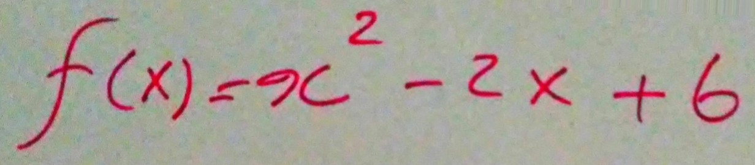
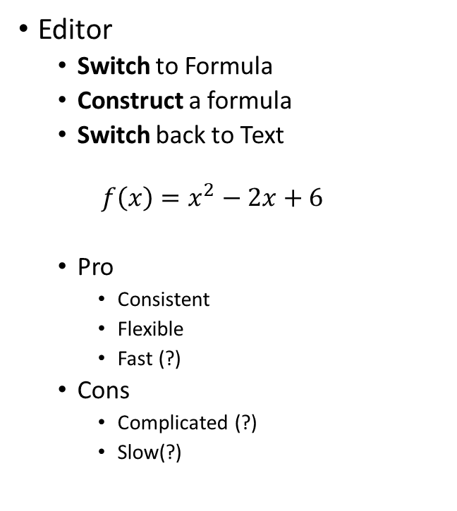
Adding Equations – Image vs Editor
Image:
Scan or Shoot & Upload
Insert > Pictures or Copy & Paste
Crop
Pro
Simple
Cons
Slow
Inflexible
Inconsistent
Editor
Switch to Formula
Construct a formula
Switch back to Text
$$f\left(x\right)=x^{2}−2x+6$$
Pro
Consistent
Flexible
Fast (?)
Cons
Complicated (?)
Slow(?)

Slide 5



Adding Equations – Point & Click vs. Keyboard
Point & Click
>Insert (>Symbols) >Equations
To Switch
Type to Construct:
$$x=12$$
Click or key [$→$] away
To Switch back
Keyboard
[Alt]= to switch
[Ctrl]= in Mac
Type to Construct:
$$x=12$$
[Alt]= to Switch back
[Ctrl]= in Mac
Remarks
“x=12” is the same as $x=12$; or is it?
Not all symbols can be generated by keystrokes; but most will.
Not all applications behave the same; but they’re mostly the same
MS Word has two Math modes: Unicode and LaTeX; here we focus on Unicode
LaTeX works on commands and Unicode reacts to keystrokes
Other Office applications do not support LaTeX Math mode;
Other Office application do not behave the way Word does

Slide 6
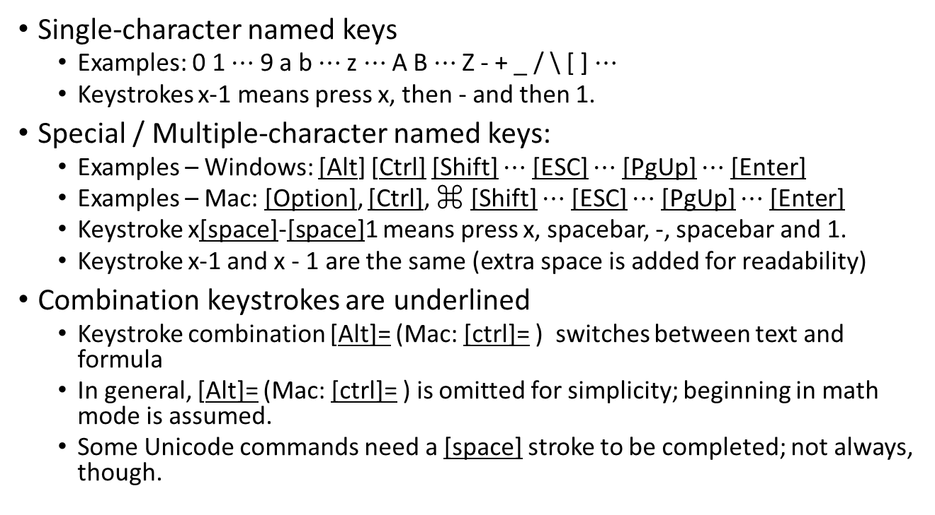
Getting Started – Notations
Single-character named keys
Examples: 0 1 $⋯$ 9 a b $⋯$z $⋯$A B $⋯$Z - + _ / \ [ ] $⋯$
Keystrokes x-1 means press x, then - and then 1.
Special / Multiple-character named keys:
Examples – Windows: [Alt] [Ctrl] [Shift] $⋯$ [ESC] $⋯$ [PgUp] $⋯$ [Enter]
Examples – Mac: [Option], [Ctrl], ⌘ [Shift] $⋯$ [ESC] $⋯$ [PgUp] $⋯$ [Enter]
Keystroke x[space]-[space]1 means press x, spacebar, -, spacebar and 1.
Keystroke x-1 and x - 1 are the same (extra space is added for readability)
Combination keystrokes are underlined
Keystroke combination [Alt]= (Mac: [ctrl]= ) switches between text and formula
In general, [Alt]= (Mac: [ctrl]= ) is omitted for simplicity; beginning in math mode is assumed.
Some Unicode commands need a [space] stroke to be completed; not always, though.

Slide 7
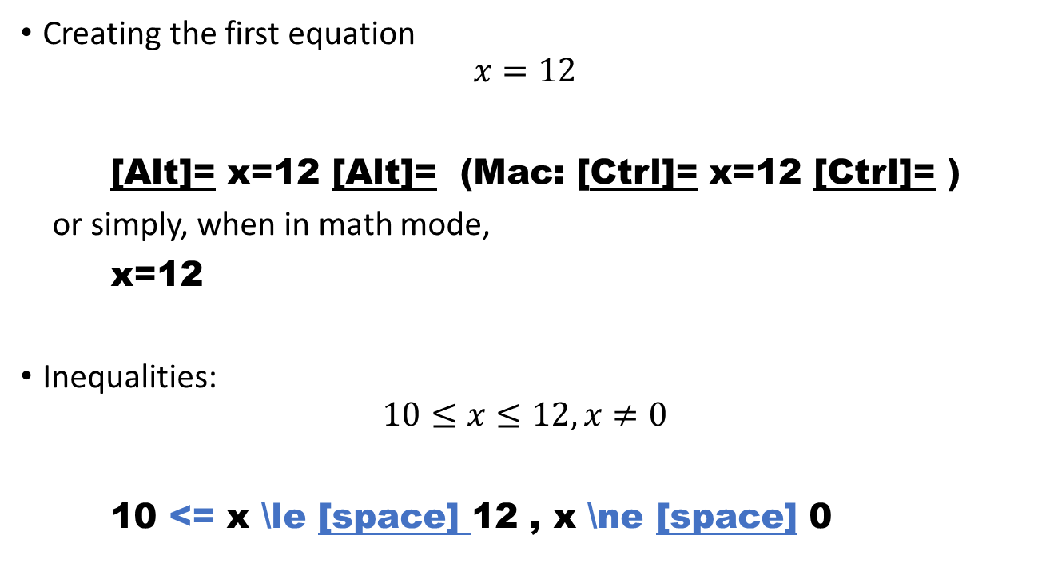
Getting Started – Equations & Inequalities
Creating the first equation
$$x=12$$
[Alt]= x=12 [Alt]= (Mac: [Ctrl]= x=12 [Ctrl]= )
or simply, when in math mode,
x=12
Inequalities:
$$10≤x≤12,x≠0$$
10 <= x \le [space] 12 , x \ne [space] 0
*

Slide 8
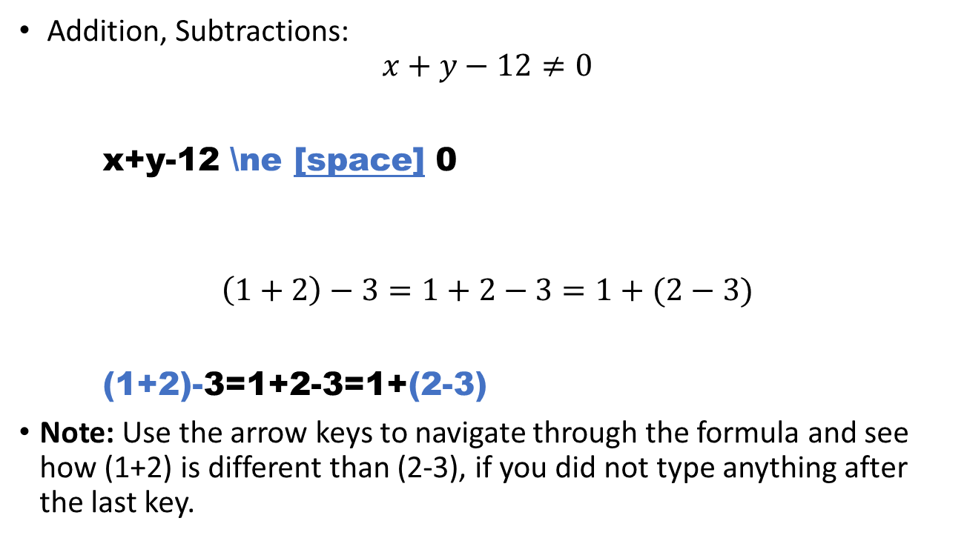
Getting Started – Basic Operations
Addition, Subtractions:
$$x+y−12≠0$$
x+y-12 \ne [space] 0
$$\left(1+2\right)−3=1+2−3=1+(2−3)$$
(1+2)-3=1+2-3=1+(2-3)
Note: Use the arrow keys to navigate through the formula and see how (1+2) is different than (2-3), if you did not type anything after the last key.

Slide 9

Getting Started – Basic Operations
Multiplication:
$$2x+3yz=54$$
2x+3yz=54
$$2×x+y⋅z=54$$
2 \times [space] x+y \cdot [space] z=54

Slide 10
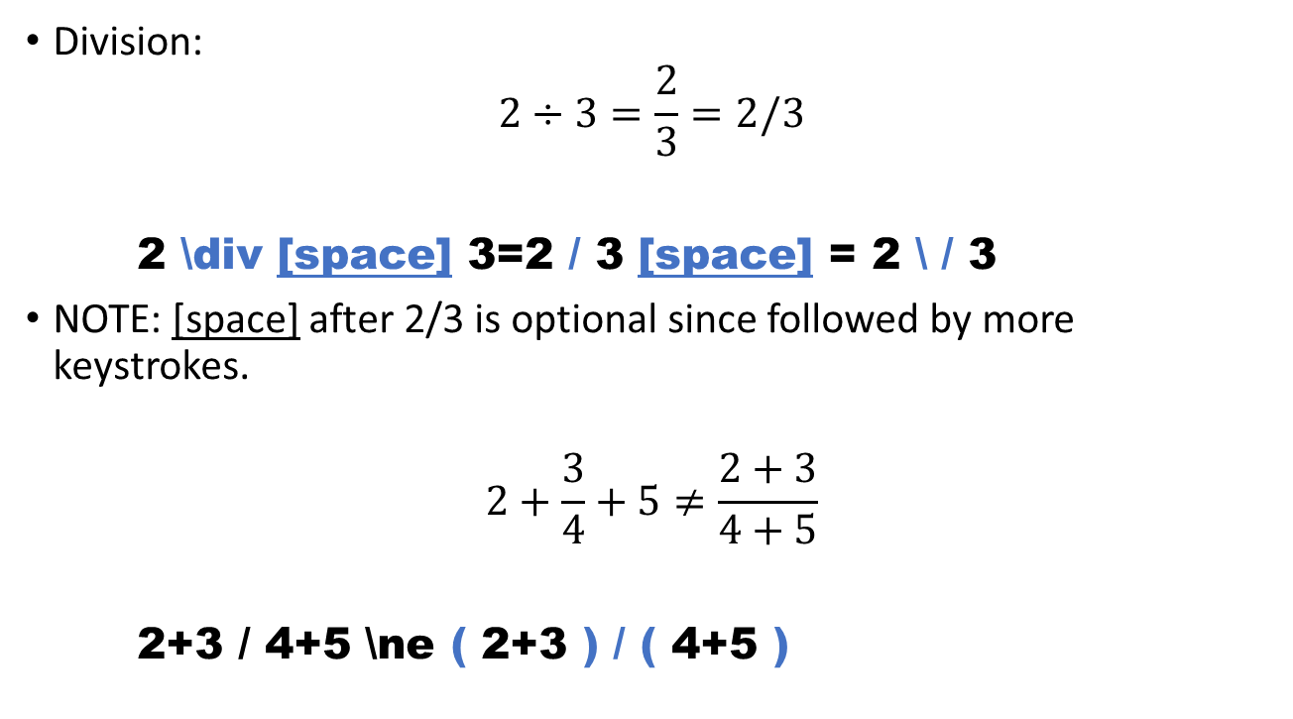
Getting Started – Basic Operations
Division:
$$2÷3=\frac{2}{3}=2/3$$
2 \div [space] 3=2 / 3 [space] = 2 \ / 3
NOTE: [space] after 2/3 is optional since followed by more keystrokes.
$$2+\frac{3}{4}+5≠\frac{2+3}{4+5}$$
2+3 / 4+5 \ne ( 2+3 ) / ( 4+5 )
*
*

Slide 11
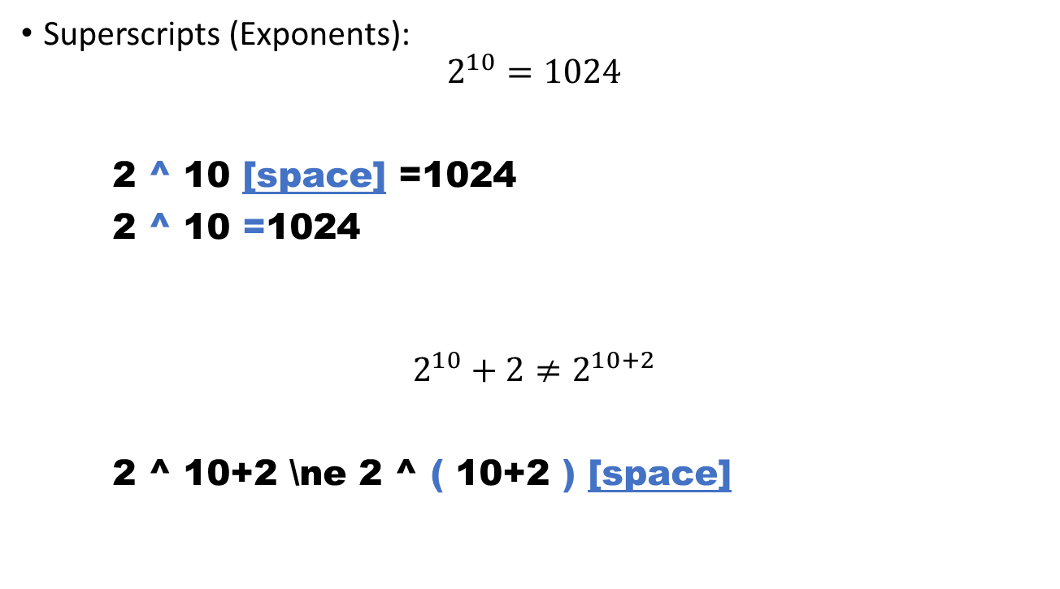
Getting Started –Superscripts/Subscripts
Superscripts (Exponents):
$$2^{10}=1024$$
2 ^ 10 [space] =1024
2 ^ 10 =1024
$$2^{10}+2≠2^{10+2}$$
2 ^ 10+2 \ne 2 ^ ( 10+2 ) [space]
*

Slide 12
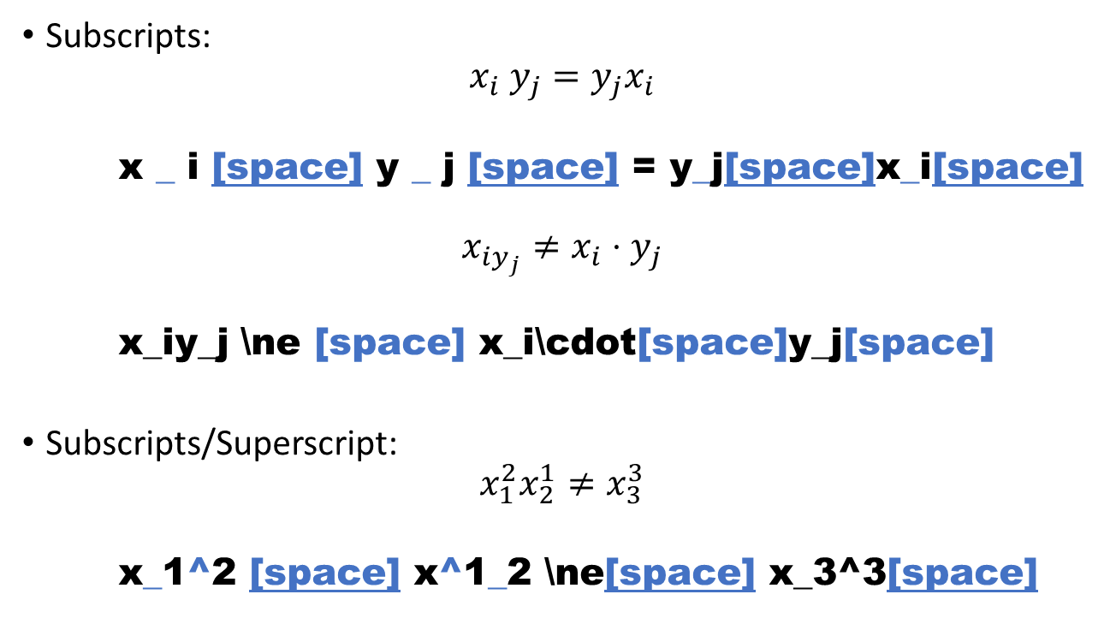
Getting Started – Superscripts/Subscripts
Subscripts:
$$x_{i} y_{j}=y_{j}x_{i}$$
x _ i [space] y _ j [space] = y_j[space]x_i[space]
$$x_{iy_{j}}≠x_{i}⋅y_{j}$$
x_iy_j \ne [space] x_i\cdot[space]y_j[space]
Subscripts/Superscript:
$$x_{1}^{2}x_{2}^{1}≠x_{3}^{3}$$
x_1^2 [space] x^1_2 \ne[space] x_3^3[space]
*

Slide 13
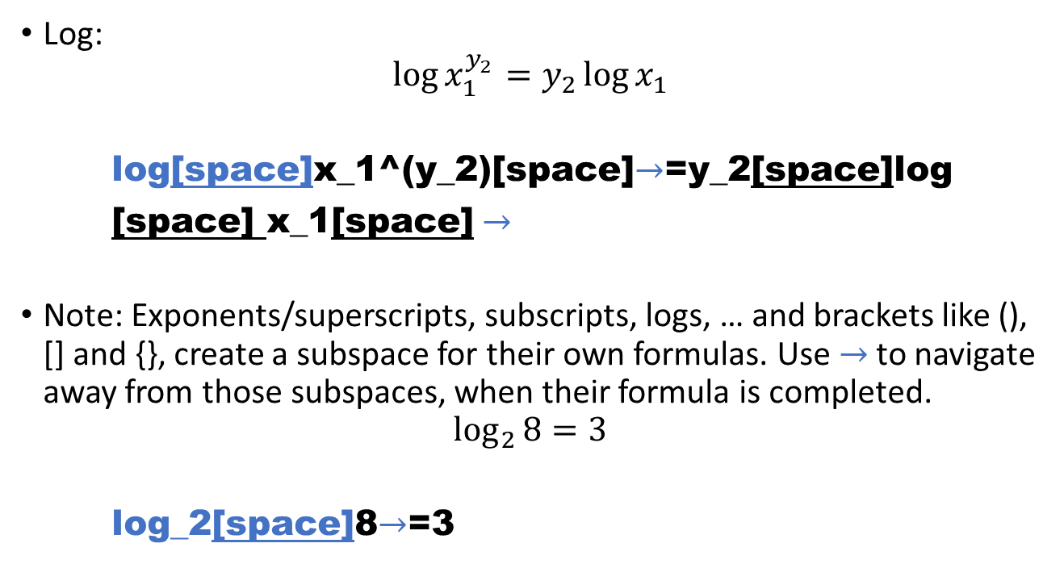
Getting Started – Log
Log:
$$\log{x_{1}^{y_{2}}}=y_{2}\log{x_{1}}$$
log[space]x_1^(y_2)[space]$→$=y_2[space]log
[space] x_1[space] $→$
Note: Exponents/superscripts, subscripts, logs, … and brackets like (), [] and {}, create a subspace for their own formulas. Use $→$to navigate away from those subspaces, when their formula is completed.
$$\log_{2}{8}=3$$
log_2[space]8$→$=3
*

Slide 14
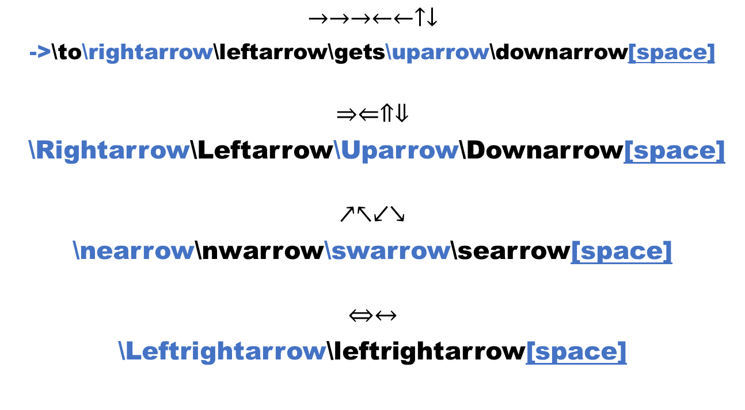
Getting Started – Arrows
$$→→→←←↑↓$$
->\to\rightarrow\leftarrow\gets\uparrow\downarrow[space]
$$⇒⇐⇑⇓$$
\Rightarrow\Leftarrow\Uparrow\Downarrow[space]
$$↗↖↙↘$$
\nearrow\nwarrow\swarrow\searrow[space]
$$⇔↔$$
\Leftrightarrow\leftrightarrow[space]
*

Slide 15
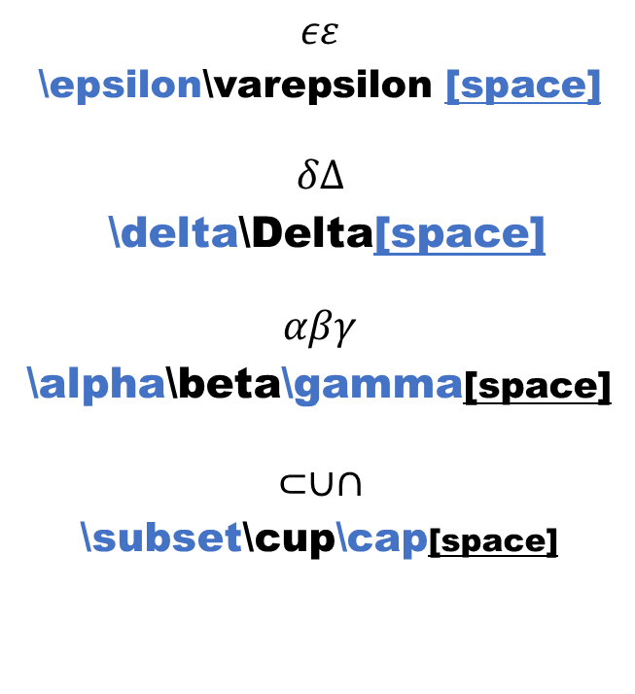
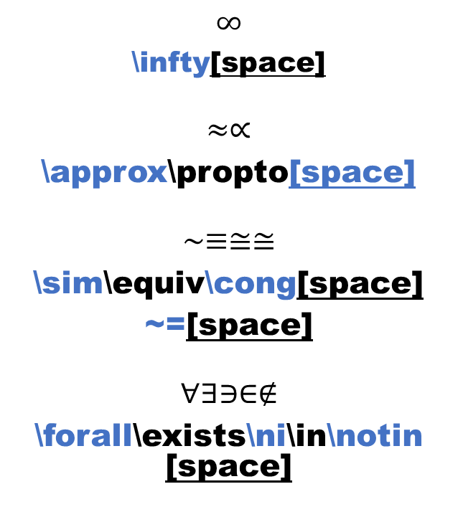
Getting Started – Symbols
$$∞$$
\infty[space]
$$≈∝$$
\approx\propto[space]
$$∼≡≅≅$$
\sim\equiv\cong[space]
~=[space]
$$∀∃∋∈∉$$
\forall\exists\ni\in\notin [space]
$$εε$$
\epsilon\varepsilon [space]
$$δΔ$$
\delta\Delta[space]
$$αβγ$$
\alpha\beta\gamma[space]
$$⊂∪∩$$
\subset\cup\cap[space]
*

Slide 16
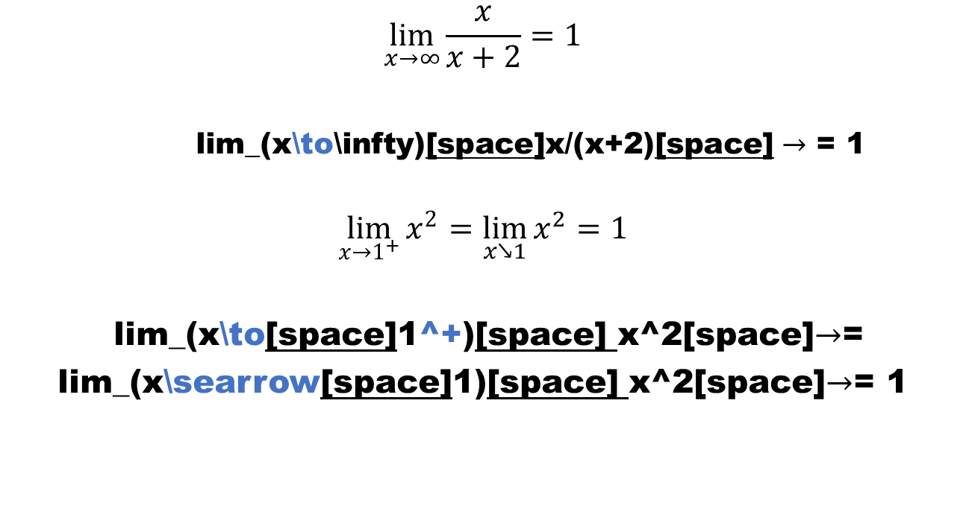
Getting Started – Limit
$$\lim_{x→∞}{\frac{x}{x+2}}=1$$
lim_(x\to\infty)[space]x/(x+2)[space] $→$ = 1
$$\lim_{x→1^{+}}{x^{2}}=\lim_{x↘1}{x^{2}}=1$$
lim_(x\to[space]1^+)[space] x^2[space]$→$=
lim_(x\searrow[space]1)[space] x^2[space]$→$= 1
*

Slide 17
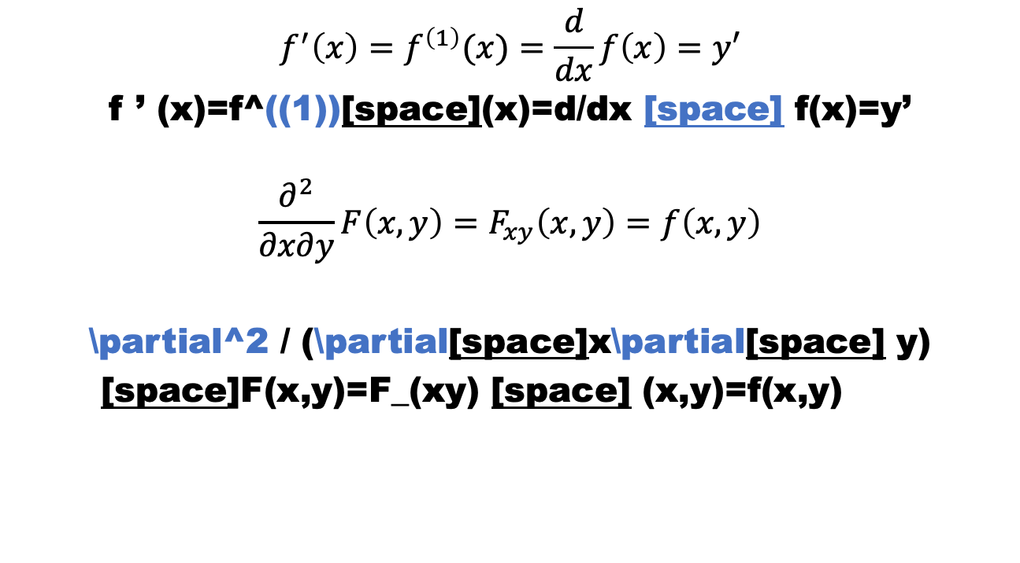
Getting Started – Derivative
$$f^{′}\left(x\right)=f^{\left(1\right)}(x)=\frac{d}{dx}f\left(x\right)=y′$$
f ’ (x)=f^((1))[space](x)=d/dx [space] f(x)=y’
$$\frac{∂^{2}}{∂x∂y}F\left(x,y\right)=F_{xy}\left(x,y\right)=f\left(x,y\right)$$
\partial^2 / (\partial[space]x\partial[space] y)
[space]F(x,y)=F_(xy) [space] (x,y)=f(x,y)

Slide 18
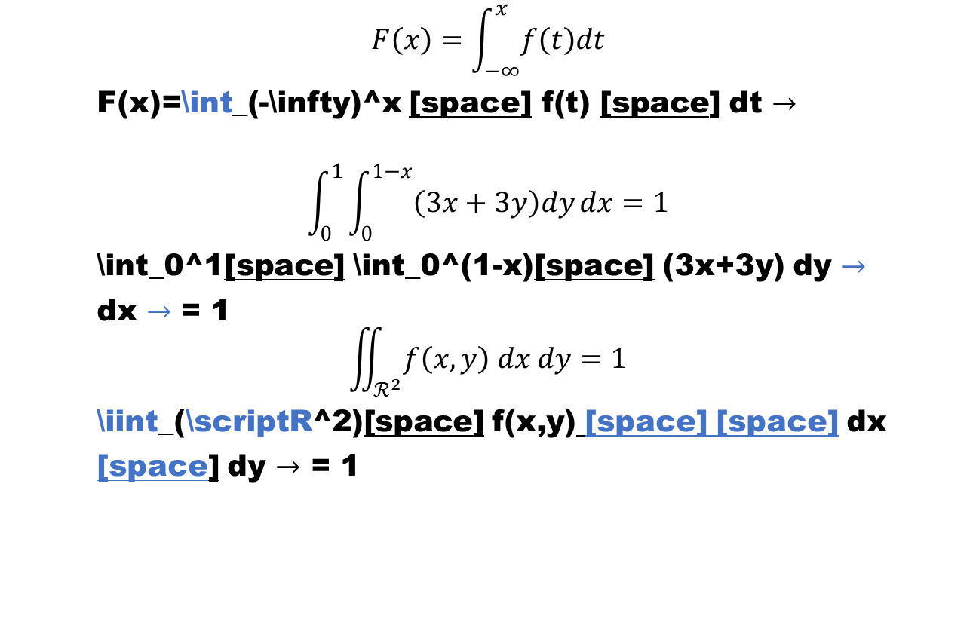
Getting Started – Integrals
$$F\left(x\right)=\int_{−∞}^{x}{f\left(t\right)dt}$$
F(x)=\int_(-\infty)^x [space] f(t) [space] dt $→$
$$\int_{0}^{1}{\int_{0}^{1−x}{\left(3x+3y\right)dy}dx}=1$$
\int_0^1[space] \int_0^(1-x)[space] (3x+3y) dy $→$
dx $→$ = 1
$$\iint_{ℛ^{2}}{f\left(x,y\right) dx dy}=1$$
\iint_(\scriptR^2)[space] f(x,y) [space] [space] dx
[space] dy $→$ = 1
*

Slide 19
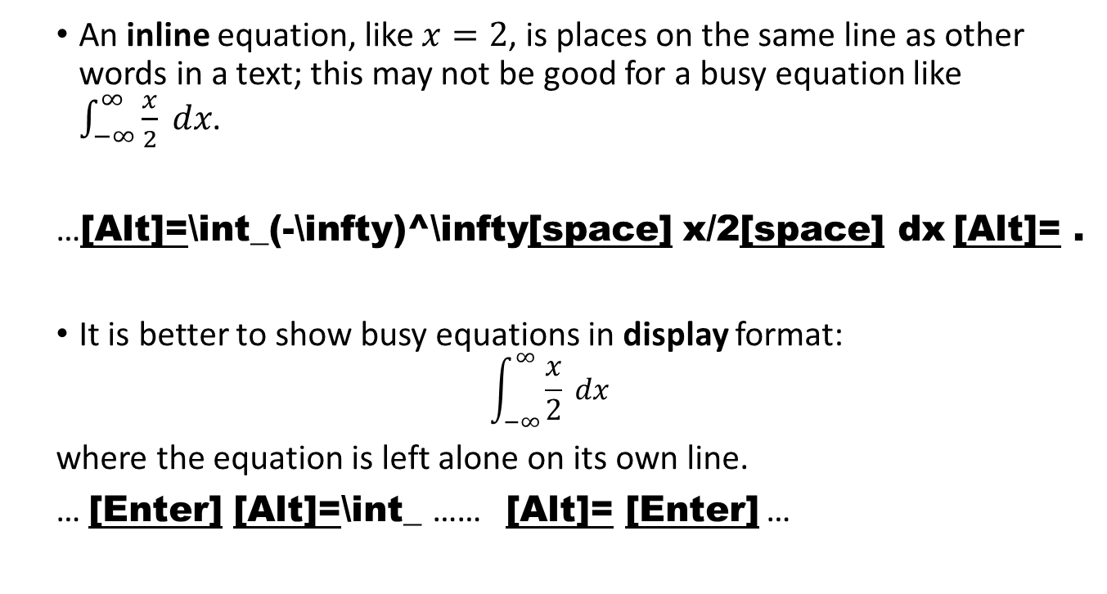
Formatting Equations – Inline vs. Display
An inline equation, like $x=2$, is places on the same line as other words in a text; this may not be good for a busy equation like $\int_{−∞}^{∞}{\frac{x}{2} dx}$.
…[Alt]=\int_(-\infty)^\infty[space] x/2[space] dx [Alt]= .
It is better to show busy equations in display format:
$$\int_{−∞}^{∞}{\frac{x}{2} dx}$$
where the equation is left alone on its own line.
… [Enter] [Alt]=\int_ …… [Alt]= [Enter] …
*
*

Slide 20
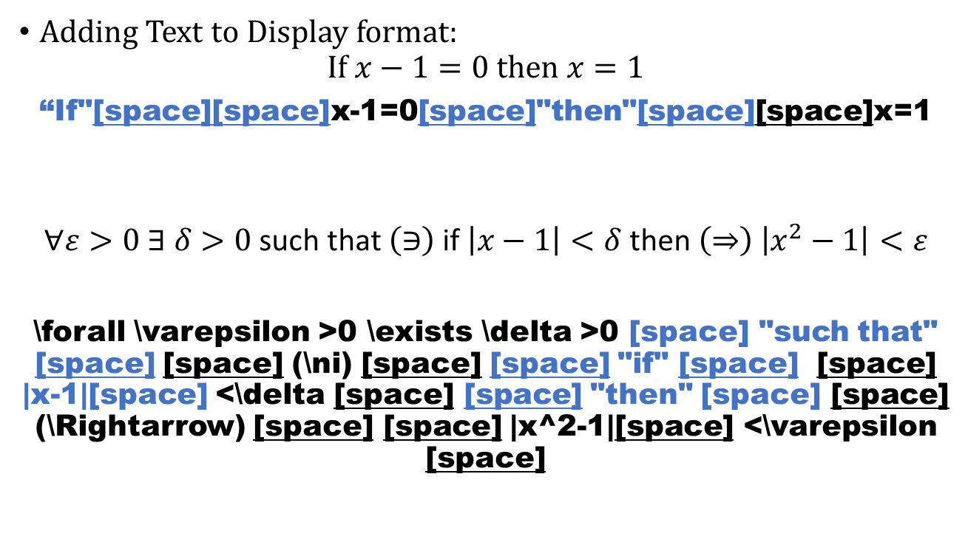
Formatting Equations – Adding Text
Adding Text to Display format:
$$\text{I}\text{f} x−1=0 \text{then} x=1$$
“If"[space][space]x-1=0[space]"then"[space][space]x=1
$$∀ε>0 ∃ δ>0 \text{such} \text{that} \left(∋\right) \text{if} \left|x−1\right|<δ \text{then} \left(⇒\right) \left|x^{2}−1\right|<ε$$
\forall \varepsilon >0 \exists \delta >0 [space] "such that" [space] [space] (\ni) [space] [space] "if" [space] [space] |x-1|[space] <\delta [space] [space] "then" [space] [space] (\Rightarrow) [space] [space] |x^2-1|[space] <\varepsilon [space]
*

Slide 21
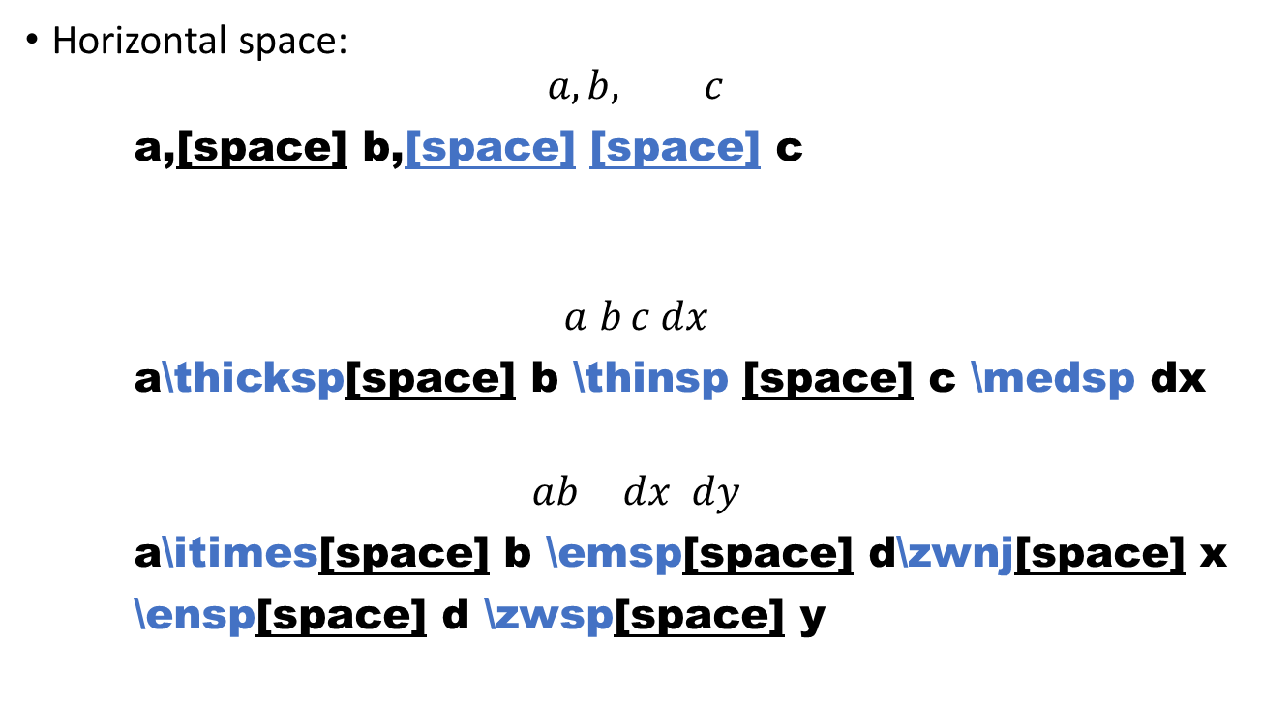
Formatting Equations – Adding Space
Horizontal space:
$$a, b, c$$
a,[space] b,[space] [space] c
$$a b c dx$$
a\thicksp[space] b \thinsp [space] c \medsp dx
$$a⁢b d‌x d​y$$
a\itimes[space] b \emsp[space] d\zwnj[space] x
\ensp[space] d \zwsp[space] y
*
*
*

Slide 22
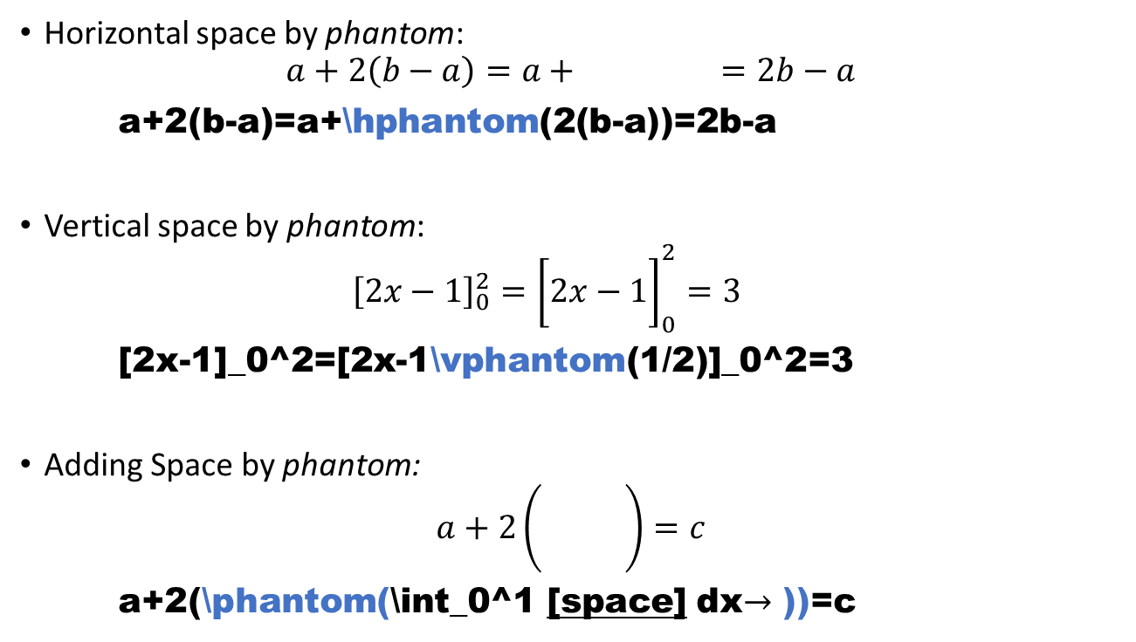
Formatting Equations – Adding Space
Horizontal space by phantom:
𝑎+2𝑏−𝑎=𝑎+2𝑏−𝑎=2𝑏−𝑎
a+2(b-a)=a+\hphantom(2(b-a))=2b-a
Vertical space by phantom:
2𝑥−102=2𝑥−11202=3
[2x-1]_0^2=[2x-1\vphantom(1/2)]_0^2=3
Adding Space by phantom:
𝑎+201𝑑𝑥=𝑐
a+2(\phantom(\int_0^1 [space] dx$→$ ))=c
*

Slide 23
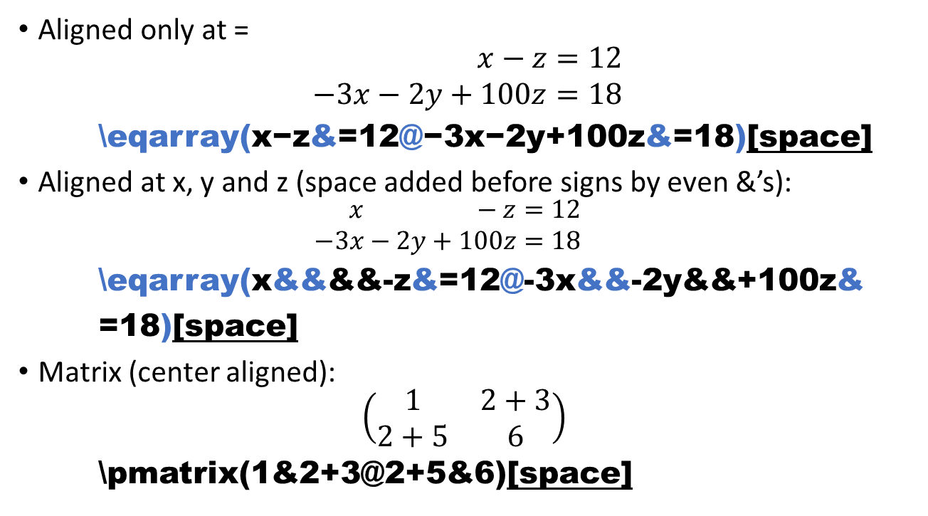
Formatting Equations – Align Equation
Aligned only at =
$$\begin{aligned}x−z&=12 \\ −3x−2y+100z&=18\end{aligned}$$
\eqarray(x−z&=12@−3x−2y+100z&=18)[space]
Aligned at x, y and z (space added before signs by even &’s):
$$\begin{aligned}&x&&&−&z=12 \\ −3&x&−2&y&+100&z=18\end{aligned}$$
\eqarray(x&&&&-z&=12@-3x&&-2y&&+100z&
=18)[space]
Matrix (center aligned):
$$\left(\begin{matrix}1 & 2+3 \\ 2+5 & 6\end{matrix}\right)$$
\pmatrix(1&2+3@2+5&6)[space]
*
*
*

Slide 24
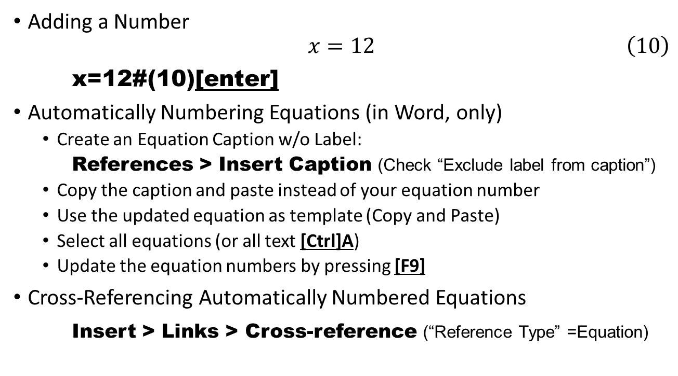
Numbering & Cross-Referencing Equations
*
Adding a Number
$$\begin{aligned}x=12\#\left(10\right)\end{aligned}$$
x=12#(10)[enter]
Automatically Numbering Equations (in Word, only)
Create an Equation Caption w/o Label:
References > Insert Caption (Check “Exclude label from caption”)
Copy the caption and paste instead of your equation number
Use the updated equation as template (Copy and Paste)
Select all equations (or all text [Ctrl]A)
Update the equation numbers by pressing [F9]
Cross-Referencing Automatically Numbered Equations
Insert > Links > Cross-reference (“Reference Type” =Equation)

Slide 25
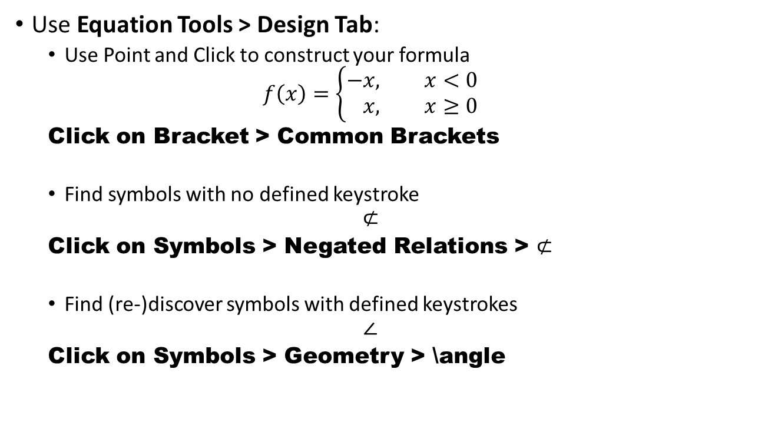
Extending Your Skills – Within Office
Use Equation Tools > Design Tab:
Use Point and Click to construct your formula
$$f\left(x\right)=\left\{\begin{aligned}−&x, x<0 \\ &x, x≥0\end{aligned}\right.$$
Click on Bracket > Common Brackets
Find symbols with no defined keystroke
$$⊄$$
Click on Symbols > Negated Relations > $⊄$
Find (re-)discover symbols with defined keystrokes
$$∠$$
Click on Symbols > Geometry > \angle

Slide 26
Extending Your Skills – In Other Applications
Type LaTeX in Titanium: use \( … \) for inline and \[…\] for display
The variable of interest is \(x\) in expression \[3ax^3-4y.\]
Type LaTeX in MATLAB’s live editor:
Enter a similar to Word’s Unicode: [Shift][Ctrl]E … (in Mac [Shift]⌘E)
Open a LaTeX GUI to enter formula: [Shift][Ctrl]L … (in Mac [Shift]⌘ L)
Type LaTeX commands directly: $...$[space]
Type LaTeX in R-Markdown or R-Notebook documents
For inline use $X$ or \(Y\);
for display use \[f(x)=2x+1\] or $$g(y)=20x-20z.$$

Slide 27
Extending Your Skills – In Other Applications
LaTeX in iOS Pages, Keynote or Numbers:
Start with [Alt]⌘E
Type LaTeX in a GUI
Stop by ⌘ [Enter]
Equations in Google Doc:
Insert>Equation
LaTeX in Google Doc:
Install Add-ons (e.g. Equation Editor ++)
NOTE: LaTeX commands could be limited. In Rmarkdown, or LaTeX scripting applications, commands can be extended by adding packages.

Slide 28
Extending Your Skills – External References
Typing Mathematics in Microsoft Word, https://en.wikibooks.org/wiki/Typing_Mathematics_in_Microsoft_Word
Using Keystrokes to Write Equations in Microsoft Office 2007 Equation Editor by Tomas B. Co, https://pages.mtu.edu/~tbco/cm416/EquationEditor_main.pdf
Microsoft Word Equation Editor, by Khitron Igal, https://www.cs.bgu.ac.il/~khitron/Equation%20Editor.pdf
The Word 2007/2010 Equation Editor by Dr. Iztok Hozo, http://www.iun.edu/~mathiho/useful/Equation%20Editor%20Shortcut%20Commands.pdf
Equation Numbering in Office 2016, by Murray Sargent, https://blogs.msdn.microsoft.com/murrays/2015/05/14/equation-numbering-in-office-2016/
Linear format equations using UnicodeMath and LaTeX in Word https://support.office.com/en-us/article/Linear-format-equations-using-UnicodeMath-and-LaTeX-in-Word-2E00618D-B1FD-49D8-8CB4-8D17F25754F8

Slide 29
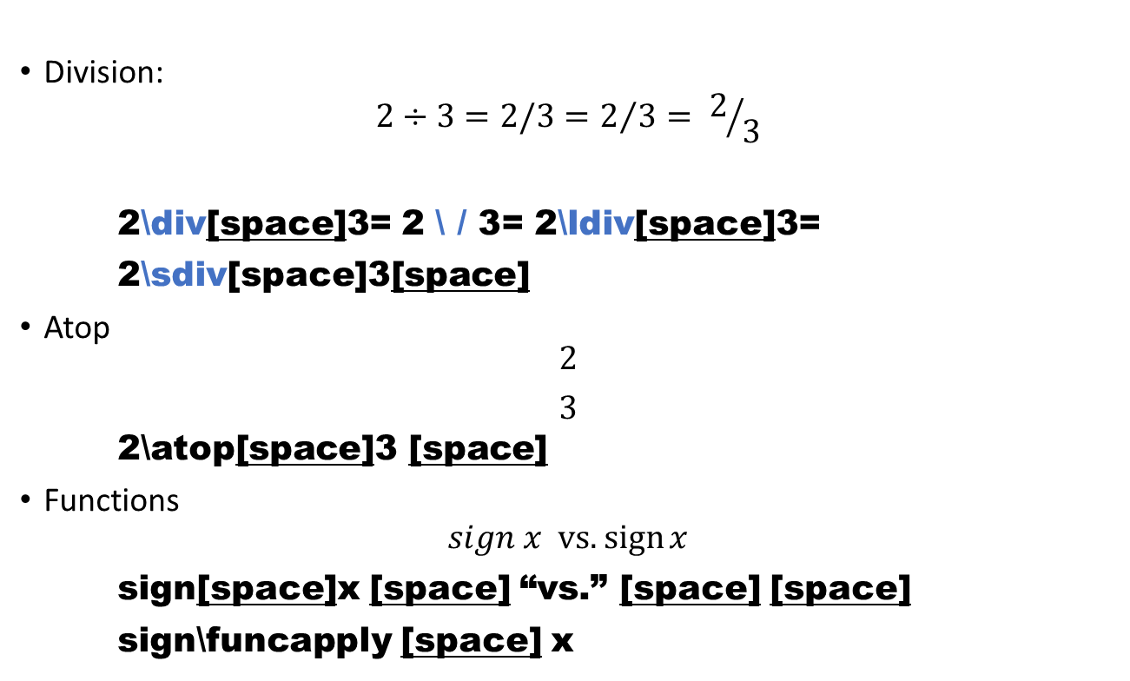
Misc. Commands
Division:
$$2÷3=2/3=2/3= 2/3$$
2\div[space]3= 2 \ / 3= 2\ldiv[space]3=
2\sdiv[space]3[space]
Atop
$${2 \atop 3}$$
2\atop[space]3 [space]
Functions
$$sign x \text{vs}\text{.} sign⁡x$$
sign[space]x [space] “vs.” [space] [space]
sign\funcapply [space] x

Slide 30
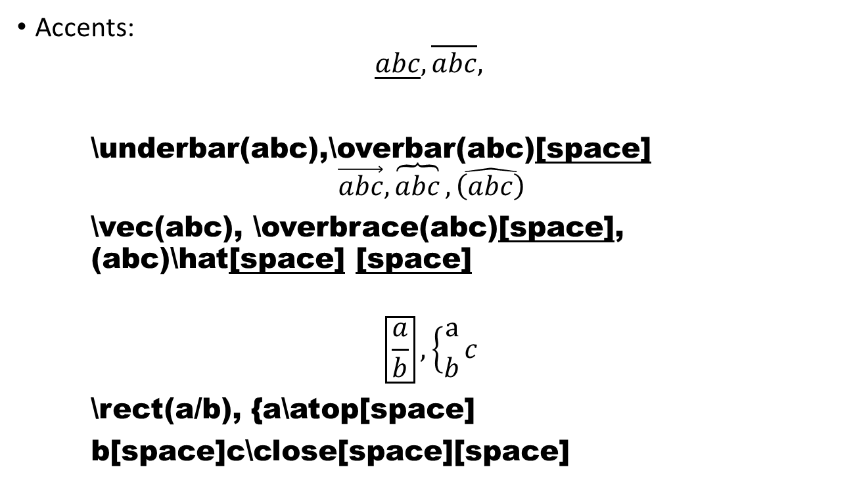
Misc. Commands
Accents:
$$\underline{abc}, \overline{abc},$$
\underbar(abc),\overbar(abc)[space]
$$\vec{abc},\overbrace{abc},\hat{\left(abc\right)}$$
\vec(abc), \overbrace(abc)[space], (abc)\hat[space] [space]
$$\boxed{\frac{a}{b}},\left\{{a \atop b}c\right.$$
\rect(a/b), {a\atop[space]
b[space]c\close[space][space]

Slide 31
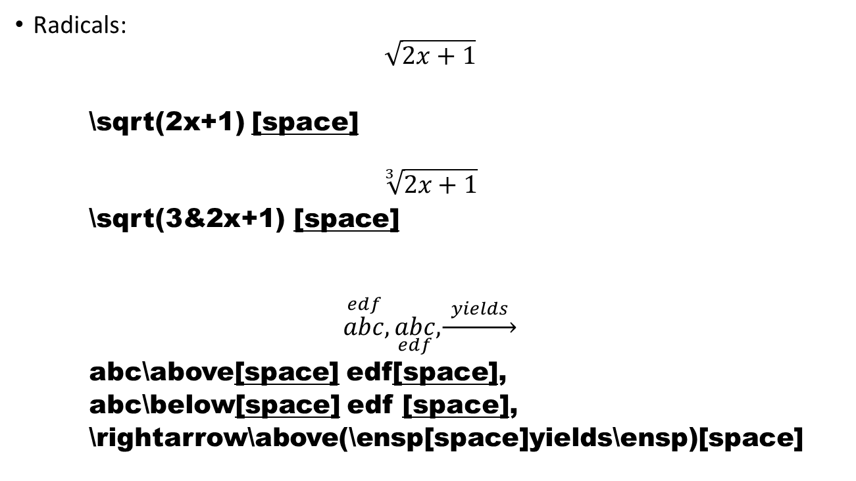
Misc. Commands
Radicals:
$$\sqrt{2x+1}$$
\sqrt(2x+1) [space]
$$\sqrt[3]{2x+1}$$
\sqrt(3&2x+1) [space]
$$\overset{edf}{abc},\underset{edf}{abc}, \underset{→}{ yields }$$
abc\above[space] edf[space],
abc\below[space] edf [space],
\rightarrow\above(\ensp[space]yields\ensp)[space]

